Slide 1


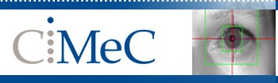
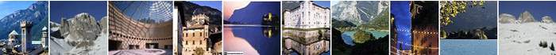
Brain Structural MRI Introduction
Louvain-la-Neuve - Neuroimaging Workshop 2019
Jorge Jovicich
Center for Mind/Brain Sciences (CIMeC),
University of Trento, Rovereto, Italy
CIMeC: https://www.cimec.unitn.it/
MRI Lab: http://r.unitn.it/en/cimec/mri
E-mail: jorge.jovicich@unitn.it

Slide 2
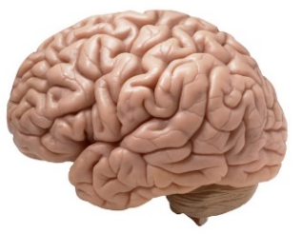
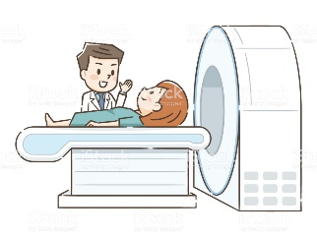
Concept map for lectures
Lecture 1
MR Image & Contrast
NMR Signal origin
MR Safety
Spatial encoding
Magnetic gradients
Pulse sequences
Powerful magnet
Radio frequency
Magnetic field gradients
Powerful magnet
Radio frequency
Magnetic field gradients
Lecture 2
Lecture 4
Structural MRI
Lecture 3
Functional MRI
Diffusion MRI
Contrast, important parameters
Sequences & artifacts
Analyses & applications
Contrast, important parameters
Sequences & artifacts
Pre-processing
Contrast, important parameters
Sequences & artifacts
Analyses & applications
Jorge Jovicich
CIMeC, University of Trento, Italy

Slide 3
Lecture 2 outline
Brain structure MRI
What is a structural MRI?
What is image contrast?
How can image contrast be manipulated?
What image analyses are common from brain structural MRI?
What are some structural MRI applications?
What are some structural MRI challenges?
Jorge Jovicich
CIMeC, University of Trento, Italy

Slide 4
Structural versus Functional MRI
Structural MRI:
Contrast sensitive to macro- or micro-structural anatomy in space
Examples
Gray matter, white matter, cerebral spinal fluid (CSF)
Iron content
Myelin content
Fat tissue
Etc.
Functional MRI:
Contrast sensitive to blood oxygenation, or perfusion or metabolism in time
Examples
Hemodynamic changes in time (during task or rest)
Blood perfusion changes
Blood volume changes
Concentration of metabolite changes
Etc.
The key thing is contrast. What is it?
Jorge Jovicich
CIMeC, University of Trento, Italy

Slide 5
Lecture 2 outline
Brain structure MRI
What is a structural MRI?
What is image contrast?
How can image contrast be manipulated?
What image analyses are common from brain structural MRI?
What are some structural MRI applications?
What are some structural MRI challenges?
Jorge Jovicich
CIMeC, University of Trento, Italy

Slide 6
Image contrast definition
Structural contrast: difference in MR signals between different tissues
Goal: maximize the contrast of interest ( USEFUL IMAGES! )
Tissue 1
Tissue 2
Water protons’
mobility/environment:
T1, T2, T2*, ρ,
Diffusion, Flow, …
T1, T2, T2*, ρ,
Diffusion, Flow, …
MR signal:
S1
S2
Contrast to Noise ratio (CNR):
Focus: structural contrast
Examples?
Jorge Jovicich
CIMeC, University of Trento, Italy

Slide 7
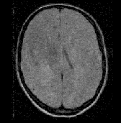
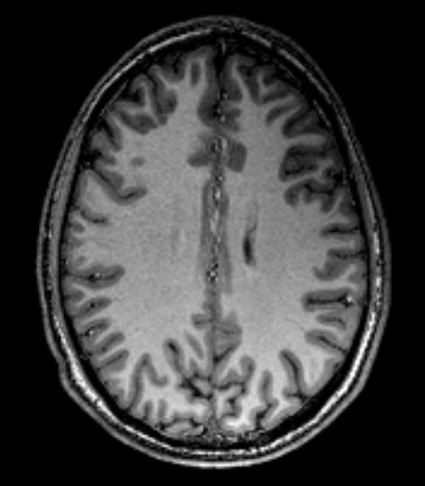
Structural image example
Poor gray/white matter contrast
Good gray/white matter contrast
(T1 contrast)
Jorge Jovicich
CIMeC, University of Trento, Italy

Slide 8
MRI contrast: what can be manipulated?
Tissue Properties: fixed
Experimental Variables
Tissue T1⁺ (ms) T2 (ms) ρ*
Fat 260 84 0.90
White Matter 780 90 0.72
Gray Matter 920 100 0.84
CSF 3000 300 1.00
Magnetic field
Pulse sequence
Pulse sequence parameters
- Repetition time: TR
- Echo time: TE
- Inversion time: TI
- RF flip angle: α
Contrast agent
T1 values for B₀ = 1.5T
ρ*: % H₂O relative to CSF
What’s the effect of these variables?
Jorge Jovicich
CIMeC, University of Trento, Italy

Slide 9
Contrast weight on the MRI signal
General MRI pulse sequence: combination of contrasts
Signal Intensity:
S(x,y) = k
ρ
T₁
T₂
×
×
×
× …
Contrast Weighting: maximize one term, minimize the others
Example: T₁-weighting
T₁
ρ
S(x,y) = k
×
×
×
T₂
× …
by choosing adequate sequence & sequence parameters
Examples?
Jorge Jovicich
CIMeC, University of Trento, Italy

Slide 10
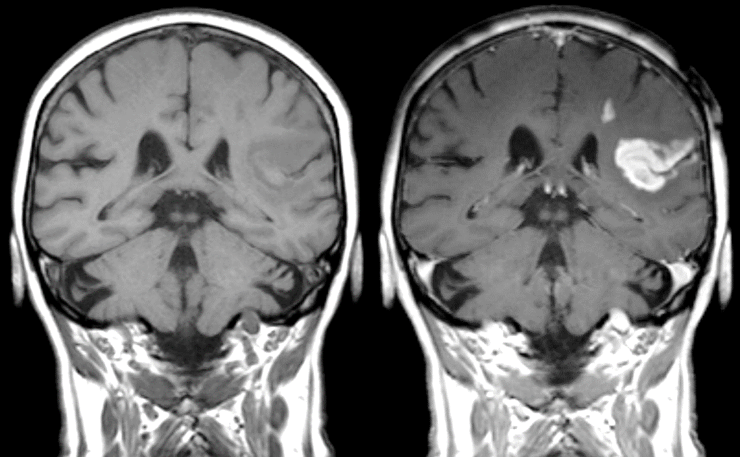
Using image contrast agents in clinics
Without contrast agent
With contrast agent
Defect of the blood-brain barrier after stroke
shown in MRI T1-weighted images.
Jorge Jovicich
CIMeC, University of Trento, Italy

Slide 11
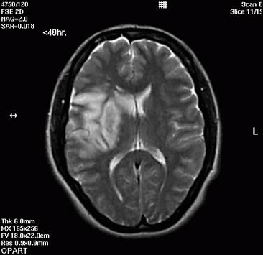
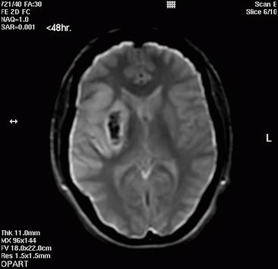
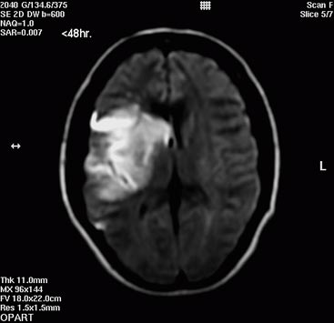
Multiple contrasts are used for diagnosis
< 48 hours postictal acute infarct in right hemisphere
T₂-weighted
T₂*-weighted
Diffusion-weighted
(infarct detection)
(presence of blood)
(full infarct extent)
Images from Toshiba Image gallery
Jorge Jovicich
CIMeC, University of Trento, Italy

Slide 12
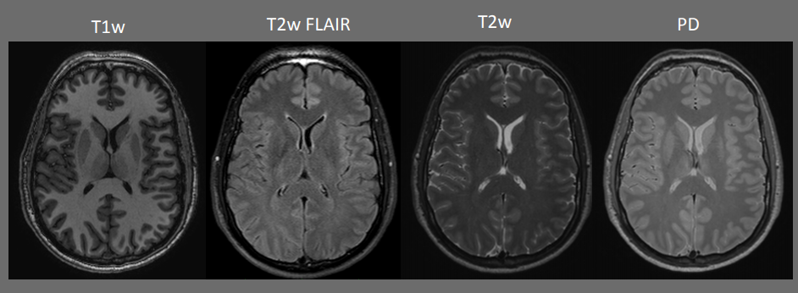
Multiple contrasts in healthy tissue
Research with healthy volunteers: endogenous natural tissue contrast
http://www.mc.vanderbilt.edu/documents/fmri/files/2013_Phys352A_StructuralMRI.pdf
T1w: T1-weighted MRI
T2w: T2-weighted MRI
T2w FLAIR: T2-weighted Fluid Attenuation Inversion Recovery
PD: Proton Density weighted MRI
Jorge Jovicich
CIMeC, University of Trento, Italy

Slide 13
Lecture 2 outline
Brain structure MRI
What is a structural MRI?
What is image contrast?
How can image contrast be manipulated?
What image analyses are common from brain structural MRI?
What are some structural MRI applications?
What are some structural MRI challenges?
Jorge Jovicich
CIMeC, University of Trento, Italy

Slide 14
Multiple options to manipulate MRI contrast
Magnetic Field
strength
MRI
Sequences
MRI Sequence
Parameters
Gradient Echo sequences:
- Proton Density weighting
- T1 weighting
- T2* weighting
Spin Echo sequences:
- Proton Density weighting
- T1 weighting
T2 weighting
Double echo: PD & T2 weighting
Inversion Recovery sequences:
- MP-RAGE: for high T1 contrast
- FLAIR: for PD or T2 weighting without CSF signal
Voxel size
Repetition time: TR
Echo time: TE
Inversion time: TI
Flip angle: α
Fat suppression: yes/no
Averaging: yes/no
Acceleration: no/how much
Slice orientation
Brain coverage
…
1.5 T
3.0 T
4.0 T
7.0 T
9.4 T
…
The choice of a particular sequence & parameters depends on the
metrics you want to derive and analyze from the images
Jorge Jovicich
CIMeC, University of Trento, Italy

Slide 15
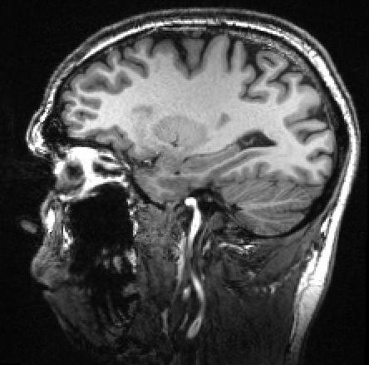
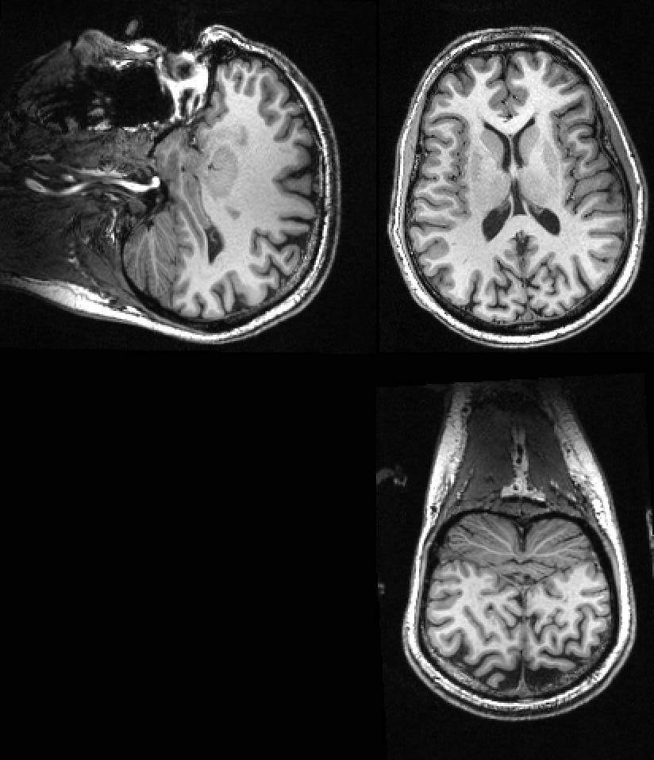
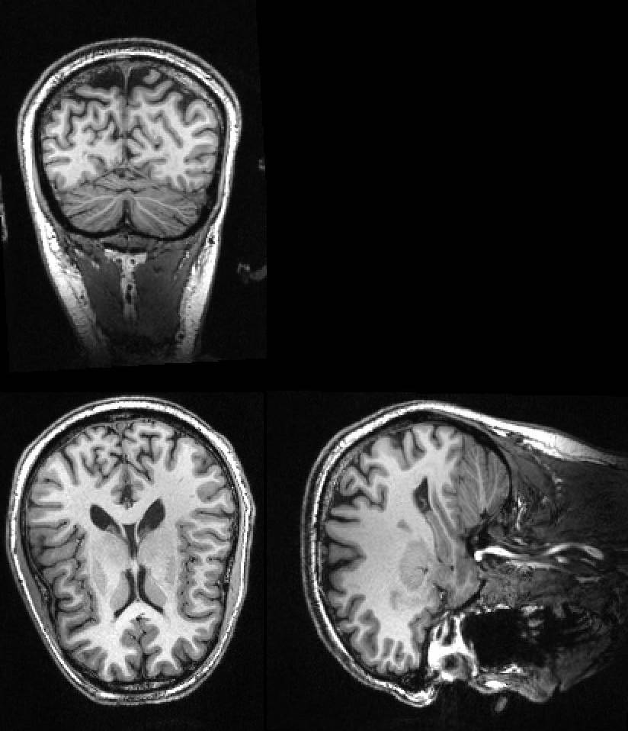
Example: T1-weighted MRI
Most common brain structural MRI contrast used
in cognitive neuroscience studies
3D MP-RAGE (T1 contrast, 4T)
Spatial Resolution: 1 x 1 x 1 mm³
Acquisition time: 5 minutes
How is this contrast obtained?
Jorge Jovicich
CIMeC, University of Trento, Italy

Slide 16
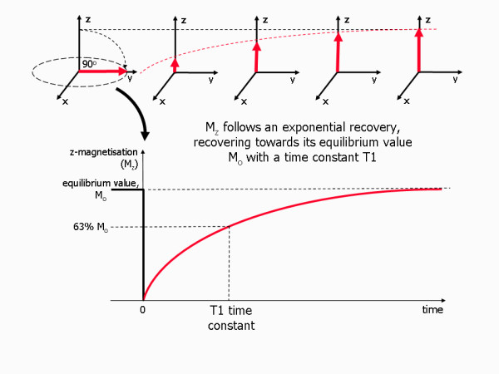
Reminder of T1 relaxation
Jorge Jovicich
CIMeC, University of Trento, Italy

Slide 17
Example: changing contrast with TR
TR: Repetition Time (time between RF excitations of the magnetization)
RF
Spatial encode
Spatial encode
Spatial encode
Mxy(t)
Mz(t)
GM: gray matter (T1 long)
WM: white matter (T1 short)
Assume T2* similar and very short in both GM & WM
time
Jorge Jovicich
CIMeC, University of Trento, Italy

Slide 18
Example: changing contrast with TR
TR: Repetition Time (time between RF excitations of the magnetization)
TR
RF
encode
encode
encode
TE
Mxy
Voltage
(Signal)
Mz
WM
GM
GM: gray matter (long T1)
WM: white matter (short T1)
time
Jorge Jovicich
CIMeC, University of Trento, Italy

Slide 19
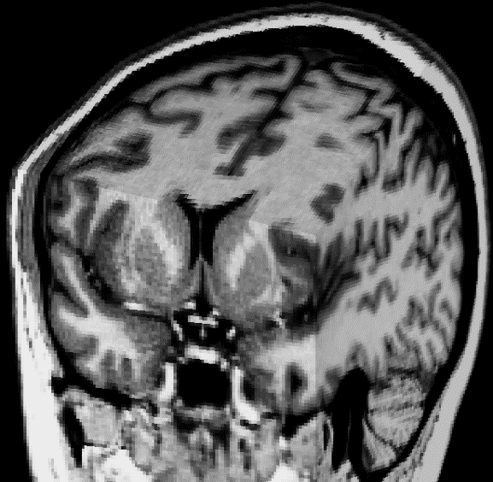
Example: changing contrast with TR
TR: Repetition Time (time between RF excitations of the magnetization)
TR
RF
encode
encode
encode
TE
Mxy
Voltage
(Signal)
Mz
WM
GM
GM: gray matter (long T1)
WM: white matter (short T1)
time
Jorge Jovicich
CIMeC, University of Trento, Italy

Slide 20
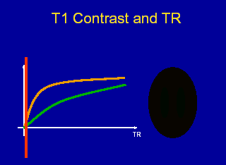
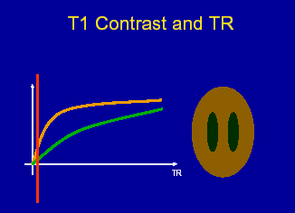
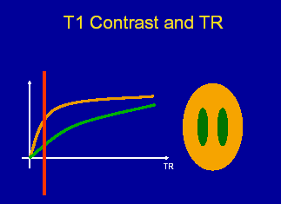
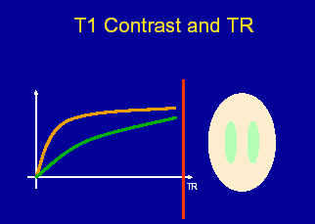
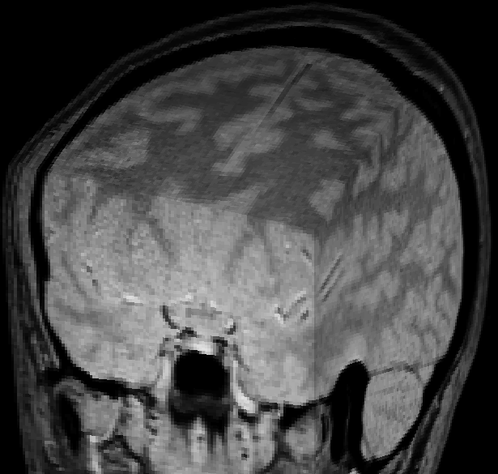
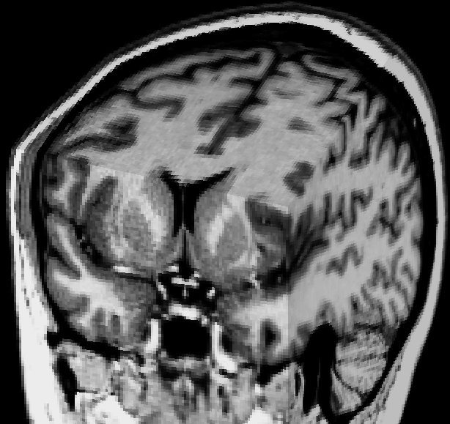
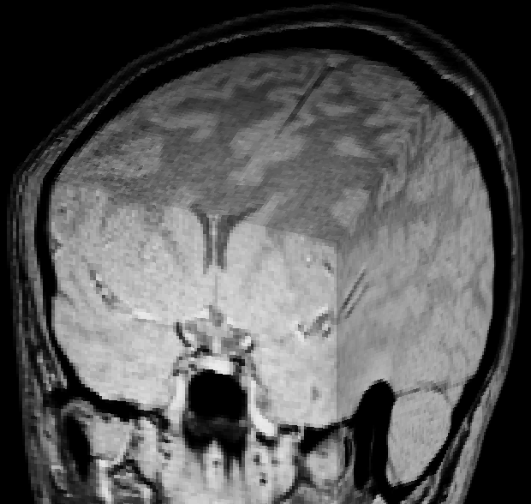
Example: changing contrast with TR
TR
To optimize the contrast-to-noise ratio between tissues
we need to know T1 of the tissues of interest
Jorge Jovicich
CIMeC, University of Trento, Italy

Slide 21
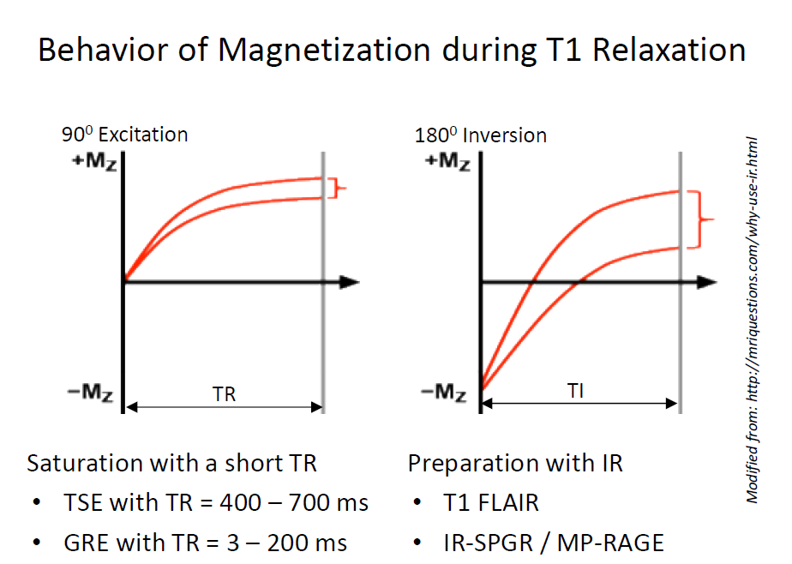
Better T1 contrast with «inversion pulse»
Jorge Jovicich
CIMeC, University of Trento, Italy

Slide 22
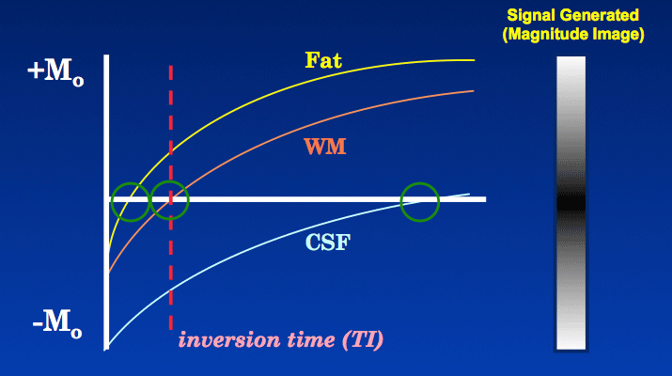
Better T1 contrast with «inversion pulse»
Inversion time choice: selects tissue to «eliminate» from image
Longitudinal magnetization recovery aftern a
180° inversion pulse (WM: white matter, CSF: cerebral spinal fluid)
Source: http://mriquestions.com/ti-to-null-a-tissue.html
Jorge Jovicich
CIMeC, University of Trento, Italy

Slide 23
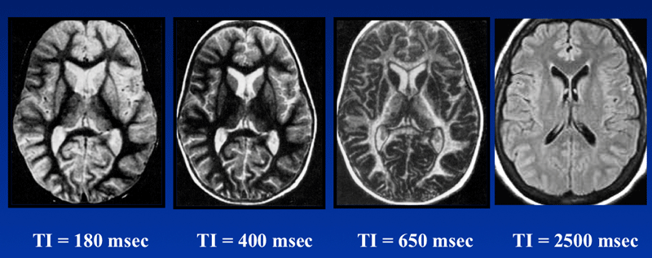
Better T1 contrast with «inversion pulse»
Choice of TI: selective suppression of tissue MRI signal
Fat suppression
(STIR sequence)
White matter suppression
Gray matter
suppression
CSF suppression
(FLAIR sequence)
Source: http://mriquestions.com/choice-of-ir-parameters.html
Jorge Jovicich
CIMeC, University of Trento, Italy

Slide 24
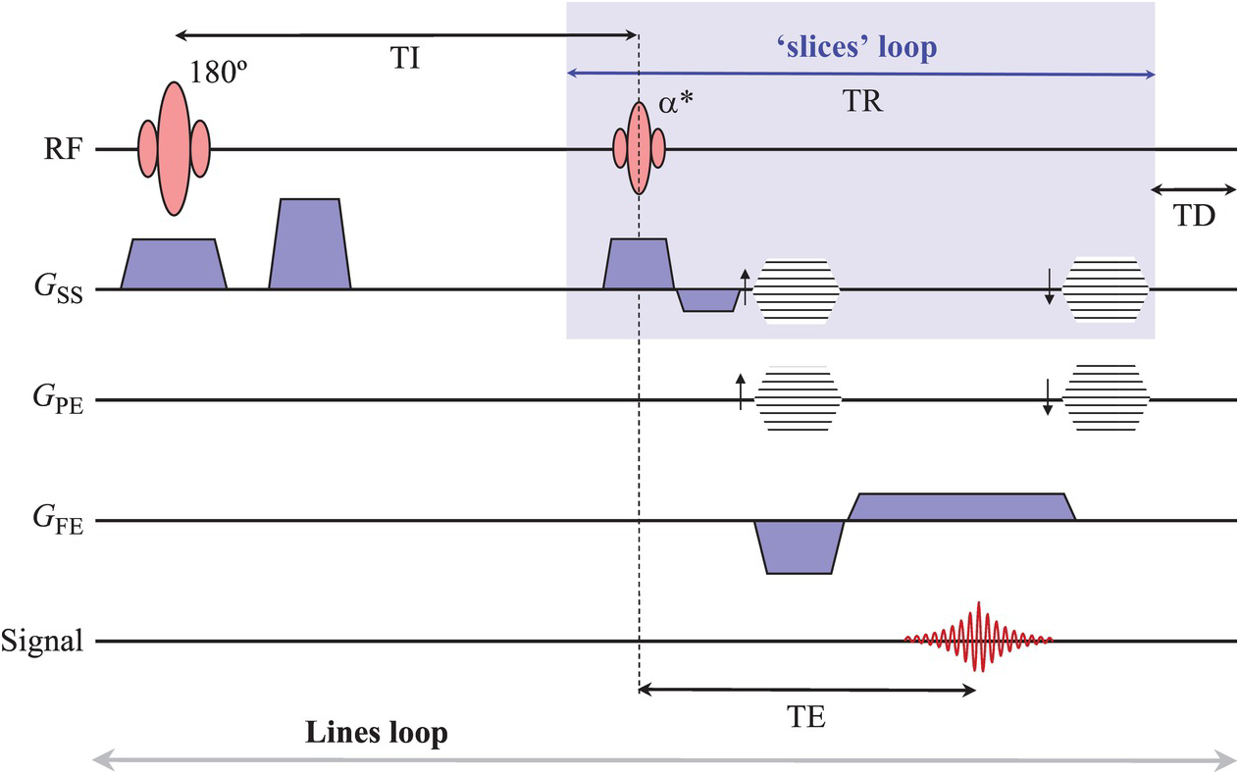
Structural T1-weighted MRI: 3D MPRAGE
Magnetization Prepared Rapid Gradient Echo (MPRAGE)
Jorge Jovicich
CIMeC, University of Trento, Italy

Slide 25
Lecture 2 outline
Brain structure MRI
What is a structural MRI?
What is image contrast?
How can image contrast be manipulated?
What image analyses are common from brain structural MRI?
What are some structural MRI applications?
What are some structural MRI challenges?
Jorge Jovicich
CIMeC, University of Trento, Italy

Slide 26
Before MRI data acquisition
0) Define what metrics do you need
Define your hypothesis testing criteria
This defines:
- acquisition protocol
- analyses strategies
Jorge Jovicich
CIMeC, University of Trento, Italy

Slide 27
Structural analysis: first step
0) Define what metrics do you need
1) MRI quality control
Problems with subject
Movement?
Inplants?
Lesions?
Position inside coil?
Problems with sequence-parameters
Contrast good?
Problems with MRI system
Inhomogeneities B0
Inhomogeneities B1
Inestabilities
Problems in laboratory
Interference with other equipment
Etc.
Jorge Jovicich
CIMeC, University of Trento, Italy

Slide 28
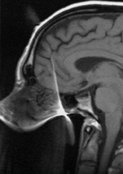
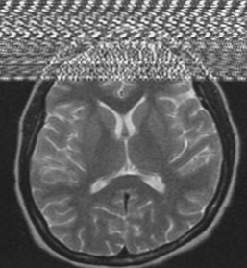
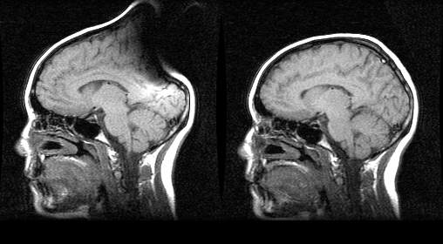
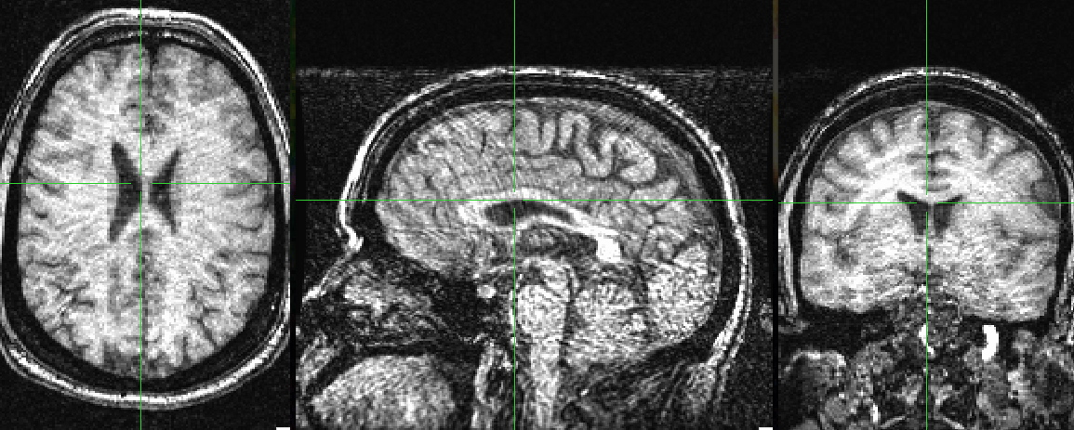
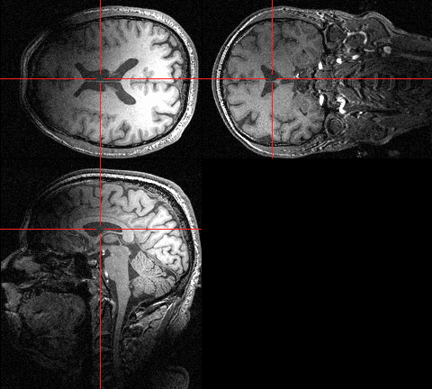
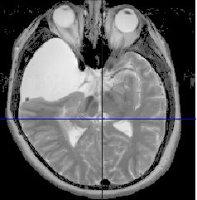
LOOK at images, LOOK for problems
Severe motion
Dental artifact
RF interference
Metalic hair pin
Wrap around
Severe signal
inhomogeneity
Poor contrast
Lesion
Jorge Jovicich
CIMeC, University of Trento, Italy

Slide 29
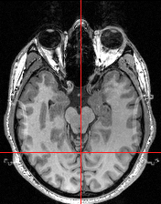
Is this OK?
Jorge Jovicich
CIMeC, University of Trento, Italy

Slide 30
Structural MRI analysis
0. Define target metrics needed
MRI quality control
Metrics extraction will depend on experimental details
Examples:
Segmentation of cortex, subcortical structures, ventricles
Acquire T1 (+ T2 for improved segmentation)
Brain morphometry (volumes, thickness, curvature, etc.)
Lesion segmentation
Acquire T2* sequence for microvascular bleeding
Acquire FLAIR sequence for deep white matter lesions
Jorge Jovicich
CIMeC, University of Trento, Italy

Slide 31
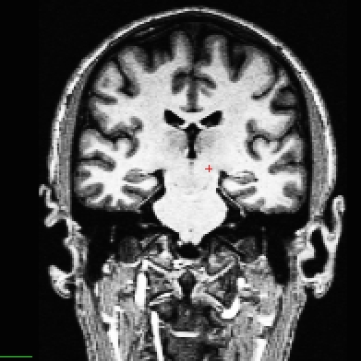
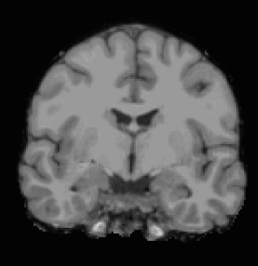
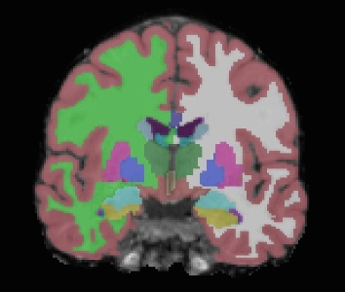
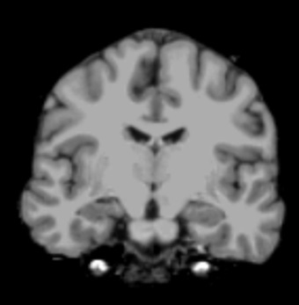
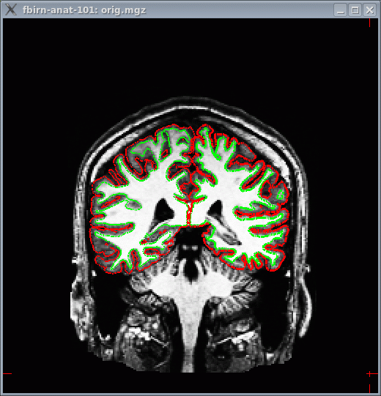
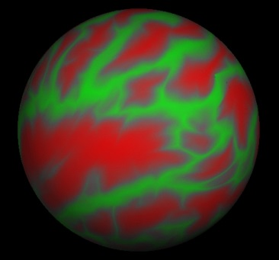
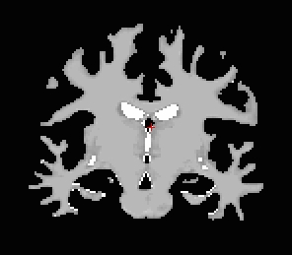
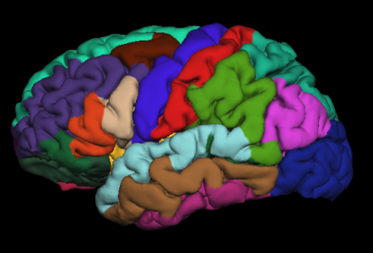
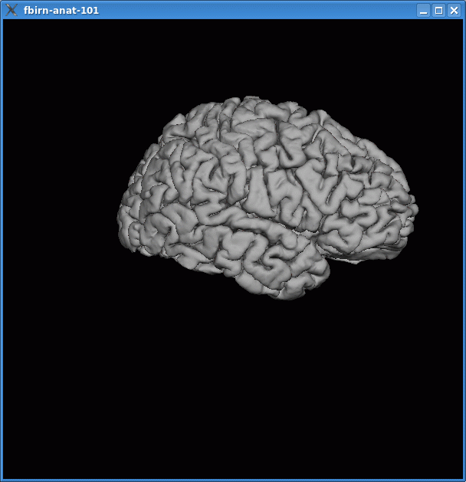
Example: Freesurfer segmentation
Fully automated segmentation of cortex, ventricles, subcortical structures
T1 Weighted
Input
Skull Stripping
Volumetric Labeling
Intensity Normalization
Gyral Labeling
Surface Atlas
Registration
White Matter
Segmentation
Stats!
Surface Extraction
https://surfer.nmr.mgh.harvard.edu/fswiki
Jorge Jovicich
CIMeC, University of Trento, Italy
Notes:
31
-T1-weighted (wm brighter than gm)
-If higher res, gets downsampled (1mm isotropic)
-Can’t go lower than 1.5mm^3

Slide 32
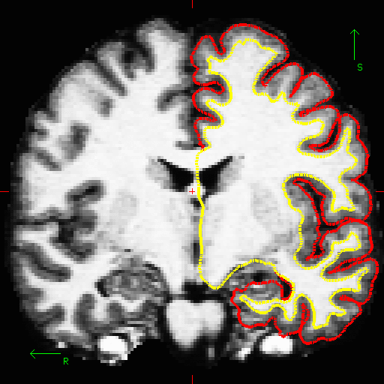
Freesurfer: WM/GM surface grows to pial surface
GM: gray matter
WM: white matter
Jorge Jovicich
CIMeC, University of Trento, Italy

Slide 33
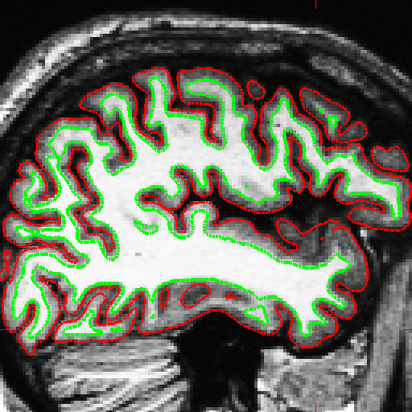
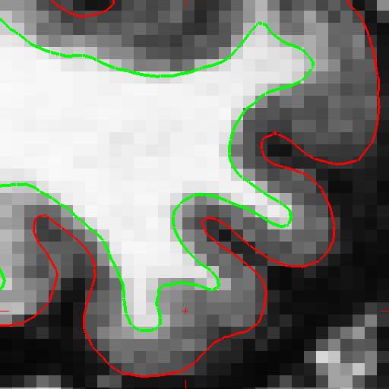
Cortical segmentation needs good T1 contrast
Cortical surface models
Cortical thickness estimates
Jorge Jovicich
CIMeC, University of Trento, Italy

Slide 34
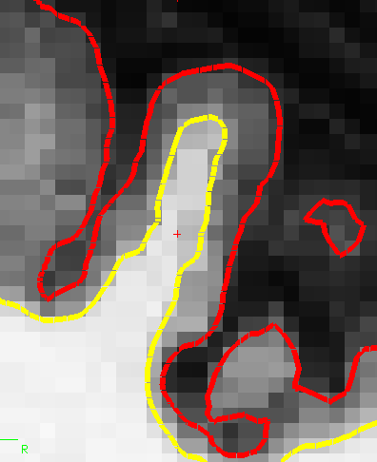
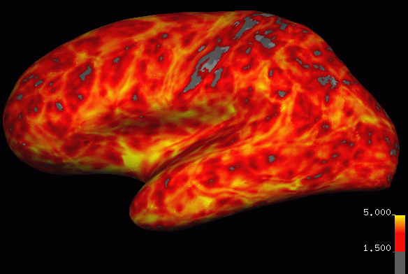
Cortical thickness estimations
Distance between white and pial surfaces
One value per vertex
Surface-based more accurate than volume-based
pial surface
mm
white/gray surface
lh.thickness, rh.thickness
Jorge Jovicich
34
CIMeC, University of Trento, Italy
Notes:
-Now that you have wm & pial surfs…get cort meas
-calculates cort thick, distance between vertices on wm and gm. blue dots are vertices (indicated by). dist from wm to gm, and gm to wm and takes average.
34

Slide 35
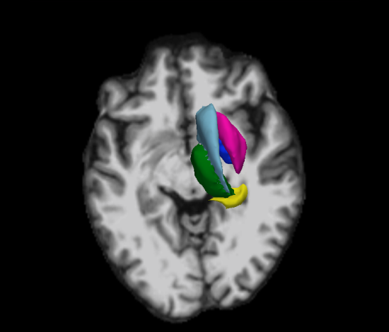
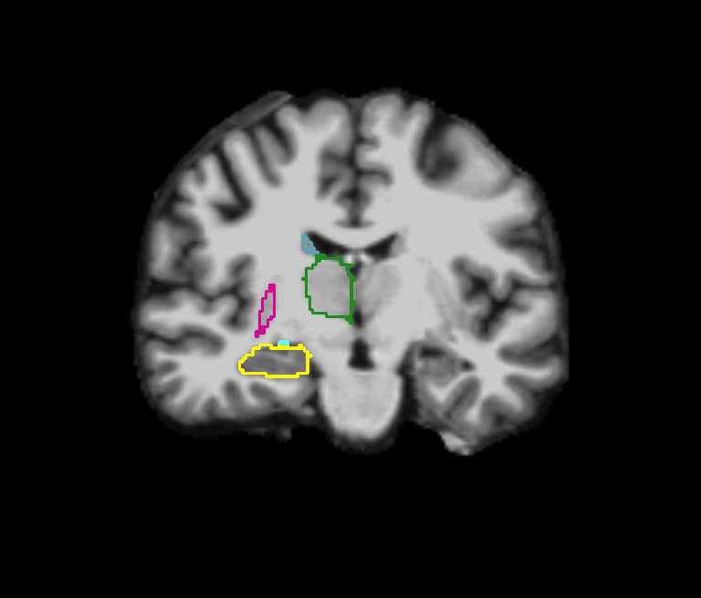


Segmentation of subcortical structures
Good gray/white contrast: subcortical structures segmentation
Subcortical structures: ROIs for fMRI analyses
Subcortical structures: Shape and volume characterization
1.5T data
Jorge Jovicich
CIMeC, University of Trento, Italy

Slide 36
Lecture 2 outline
Brain structure MRI
What is a structural MRI?
What is image contrast?
How can image contrast be manipulated?
What image analyses are common from brain structural MRI?
What are some structural MRI applications?
What are some structural MRI challenges?
Jorge Jovicich
CIMeC, University of Trento, Italy

Slide 37
Structural MRI: Application examples
Medical anatomical information
Anatomical information for functional studies
Registration with other MRI data
Same subject: other images, other acquisition sessions
Different subjects: group analyses
Registration with data from other modalities (PET, EEG, MEG)
Development of tissue models (dipoles for EEG, MEG)
Morphometry analyses
Comparisons across populations (healthy or not)
Correlation with behavioural or demagraphics measures
Treatment effects (e.g., learning, therapeutical, etc.)
Anatomical covariance (network analyses)
Tissue mapping (T1, T2, T2*, myelin, etc.)
Jorge Jovicich
CIMeC, University of Trento, Italy

Slide 38





Structural MRI: multisite hippocampal segmentation
to study Alzheimer's disease progression
Vendor T1-weighted 3D MRI
MPRAGE, 1x1x1 mm³
Two acquisitions (∼5 min each)
Jorge Jovicich
CIMeC, University of Trento, Italy

Slide 39



Structural biomarkers with differential disease progression
150 amnestic Mild Cognitive Impaired patients
Followed longitudinally: T0, T6, T12, T18, T24
Separated in low risk (negative) and high risk (positive) based on CSF amyloid/p-tau levels
Marizzoni et al., JAD 2018

Slide 40
Lecture 2 outline
Brain structure MRI
What is a structural MRI?
What is image contrast?
How can image contrast be manipulated?
What image analyses are common from brain structural MRI?
What are some structural MRI applications?
What are some structural MRI challenges?
Jorge Jovicich
CIMeC, University of Trento, Italy

Slide 41

3D MPRAGE: Most common brain T1
https://www.ncbi.nlm.nih.gov/pubmed/?term=mprage+or+multiecho+mprage+or+mp2rage
Lots of interest
Lots of optimization work
Optimization criteria reflect challenges, and include:
Tissue contrast-to-noise ratio
Intensity non-uniformities
Image distortions
Spatial and temporal resolution
Strategies for motion correction
Reproducibility and accuracy of segmentations
Jorge Jovicich
CIMeC, University of Trento, Italy

Slide 42
Structural MRI: Challenges
Optimization of image contrast
Head movement correction (retrospective, prospective)
Optimization of spatial-temporal resolution
Optimization of automated segmentations
Validation of segmentations (histology)
Multi-vendor protocol harmonization
…
Jorge Jovicich
CIMeC, University of Trento, Italy

Slide 43

Anatomical challenge: differentiate gray matter border (pial surface) from dura
Lerch et al., Nat Neurosc Rev 2017
(3T, 3D MPRAGE, The dura and the cortex. 380µm × 380µm × 1 mm image (average of 7 scans of 9 min each, motion corrected
T1= 900 ms; TR = 2,250, TE = 4.35, flip = 9°; 32-channel array)
https://en.wikipedia.org/wiki/Meninges
Jorge Jovicich
CIMeC, University of Trento, Italy

Slide 44

Pial misplacement
Segmentation errors:
Tissue that is neither white nor gray matter (like blood vessels, dura or pial), get wrongly classified as one of the two just because of similar image intensity values
Dura or Blood Vessel
White/Gray OK, but
Pial Inaccurate
Dura and GM have extremely similar intensity characteristics on most T1-weighted sequences (but different T2*!).
https://surfer.nmr.mgh.harvard.edu/
Jorge Jovicich
CIMeC, University of Trento, Italy

Slide 45
Gray matter segmentation errors
Missclassification of sulcal vessels as GM
Jorge Jovicich
CIMeC, University of Trento, Italy

Slide 46


Skull stripping errors
Parts of brain tissue removed
Such errors are ONLY detected by VISUAL quality assurance
YOU NEED TO LOOK AT THE DATA AND RESULTS
Jorge Jovicich
CIMeC, University of Trento, Italy

Slide 47
Structural MRI: Challenges
Optimization of image contrast
Head movement correction (retrospective, prospective)
Optimization of spatial-temporal resolution
Optimization of automated segmentations
Validation of segmentations (histology)
Multi-vendor protocol harmonization
…
Jorge Jovicich
CIMeC, University of Trento, Italy

Slide 48

Head motion in structural MRI
Brain morphometry estimates are useful biomarkers
Problem: head motion
Useful?
Ringing
Blurring
Jorge Jovicich
CIMeC, University of Trento, Italy

Slide 49


Head motion biases morphometry data
Experiment design:
12 healthy adults, 3T MRI
For each subject:
Scan still
Scan during 3 motion conditions
Segment both scans
Quantify morpohmetry changes
Different Motion Levels across Motion Types
Jorge Jovicich
CIMeC, University of Trento, Italy

Slide 50
Prospective motion correction reduces biases
Experiment design:
12 healthy adults, 3T MRI
For each subject:
Scan still
Scan during 3 motion conditions (no mc)
Scan during 3 motion conditions (mc)
Segment both scans
Quantify morpohmetry changes
Jorge Jovicich
CIMeC, University of Trento, Italy

Slide 51





Estimation motion degree from MPRAGE
3D MPRAGE: Parkinson’s Progression Markers Initiative
Groups | Age (years) | Gender
HC: n=84 | 59.6 ± 10.9 | M 54/ F 30
PD: n=124 | 60.4 ± 9.8 | M 77/F 47
Group differences | T=-0.44, p=0.66 | Χ²=0.10, p=0.75
Motion Metrics evaluated:
Average Edge Strength (AES)
Image entropy
Jorge Jovicich
CIMeC, University of Trento, Italy

Slide 52
Structural MRI: Challenges
Optimization of image contrast
Head movement correction (retrospective, prospective)
Optimization of spatial-temporal resolution
Optimization of automated segmentations
Validation of segmentations (hystology)
Multi-vendor protocol harmonization
…
Jorge Jovicich
CIMeC, University of Trento, Italy

Slide 53

Multicentric morphometry optimizations
Pharmacog study findings for structural T1 harmonization:
Despite MR site variability, vendor sequences + harmonized protocol give good quality automated segmentations
Accelerated MPRAGE ∼ non-accelerated
Time efficient, lower head motion sensitivity
Longitudinal Freesurfer (LG) more reliable than
cross-sectional Freesurfer (CS)
Averaging 2 MPRAGE improves hippo. subfields
Absolute % volume reproducibility error
Jovicich et al., Neuroimage 2013
Marizzoni et al., Neuroimage 2015
Jorge Jovicich
CIMeC, University of Trento, Italy

Slide 54
Multicentric morphometry optimizations
Practical consecuences of reproducibility improvements
Sample size ratio needed to have the same power analysis using LG instead of CS stream. The percentage of subjects needed is less than 50% for most of the structures considered.
Left and right hemispheric structure labels are: Hp = hippocampus, Amy = amygdala, Cau = caudate, Put = putamen, Pal = pallidum, Thal = thalamus and Ent = entorhinal cortex.
Jorge Jovicich
CIMeC, University of Trento, Italy

Slide 55
Lecture 2 outline
Brain structure MRI
What is a structural MRI?
What is image contrast?
How can image contrast be manipulated?
What image analyses are common from brain structural MRI?
What are some structural MRI applications?
What are some structural MRI challenges?
Jorge Jovicich
CIMeC, University of Trento, Italy

Slide 56



Complementary reading
https://www.sciencedirect.com/journal/neuroimage/vol/170/suppl/C
Free brain segmentation software tools include:
Freesurfer: https://surfer.nmr.mgh.harvard.edu/fswiki
SPM: https://www.fil.ion.ucl.ac.uk/spm/
ANTS: http://stnava.github.io/ANTs/
FSL: https://fsl.fmrib.ox.ac.uk/fsl/fslwiki/FAST
Functional connectivity parcellation (9)
Segmentation of different structures (9)
Atlas of (sub)cortical cytoarchitectonics areas (3)
White matter bundles (4)
Quality of cortical models (3)
Multi-modality (task) areal parcellation (5)
Automated segmentation of structural MRI data (5)
Jorge Jovicich
CIMeC, University of Trento, Italy

Slide 57
Concept map for lectures
Lecture 1
MR Image & Contrast
NMR Signal origin
MR Safety
Spatial encoding
Magnetic gradients
Pulse sequences
Powerful magnet
Radio frequency
Magnetic field gradients
Powerful magnet
Radio frequency
Magnetic field gradients
Lecture 2
Lecture 4
Structural MRI
Lecture 3
Functional MRI
Diffusion MRI
Contrast, important parameters
Sequences & artifacts
Analyses & applications
Contrast, important parameters
Sequences & artifacts
Pre-processing
Contrast, important parameters
Sequences & artifacts
Analyses & applications
Jorge Jovicich
CIMeC, University of Trento, Italy

